Slide 1
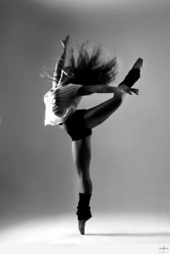
Jazz dance as a hobby
Hannele Räsänen
Helsinki university

Slide 2
As an Exercise
Jazz dance classes consist of isolation of different parts of the body and rhythmical, vibrant movements
Jazz techniques
Dance move combinations
Big and small jump
Several different kind of pirouettes
Pliés, tandues
Central body control
In the end small dances

Slide 3
Dance Group
Same tight core group for several years
Good friends, social aspect
Dance lovers, everyone is there for the dance
Pears, something important in common
Stress relive, get your mind out of everything else

Slide 4
Performing
Once a year we perform a dance for audience of 200 , with several other dance hobbyist groups
Gives more to the rehearsals when you know you will have an audience
Focus in performing a dance not just repeating moves
Just plain fun!

